Slide 1
Lesson 1

Slide 2
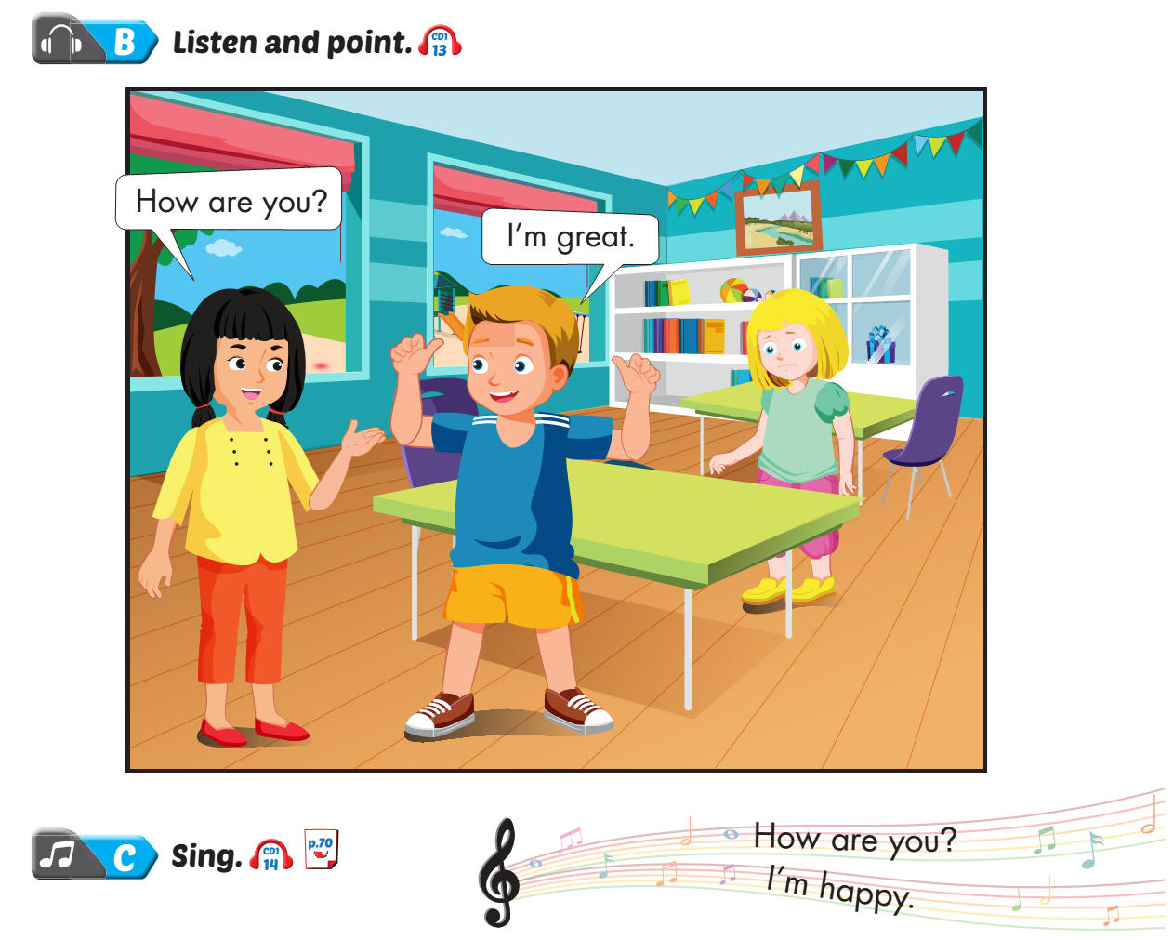
Lesson 1
Notes:
Click on the words, they will move and match up with the pictures.

Slide 3
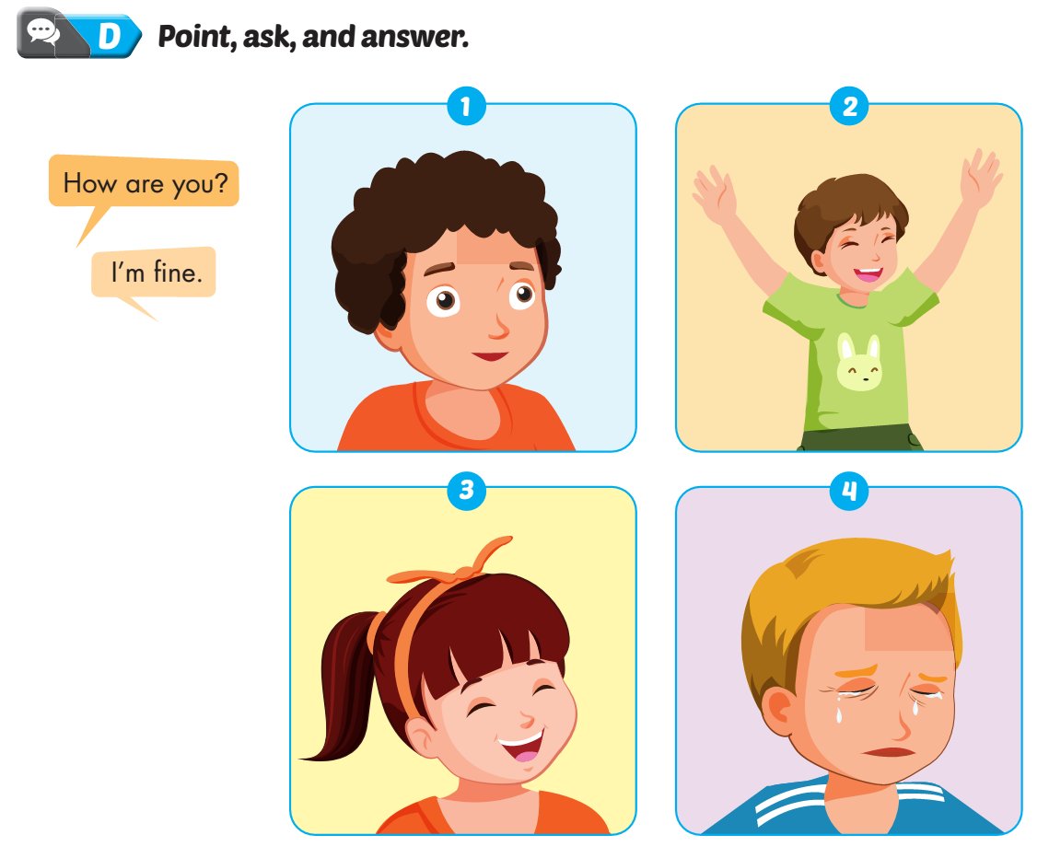
Lesson 1
Notes:
Click on the words, they will move and match up with the pictures.

Slide 4
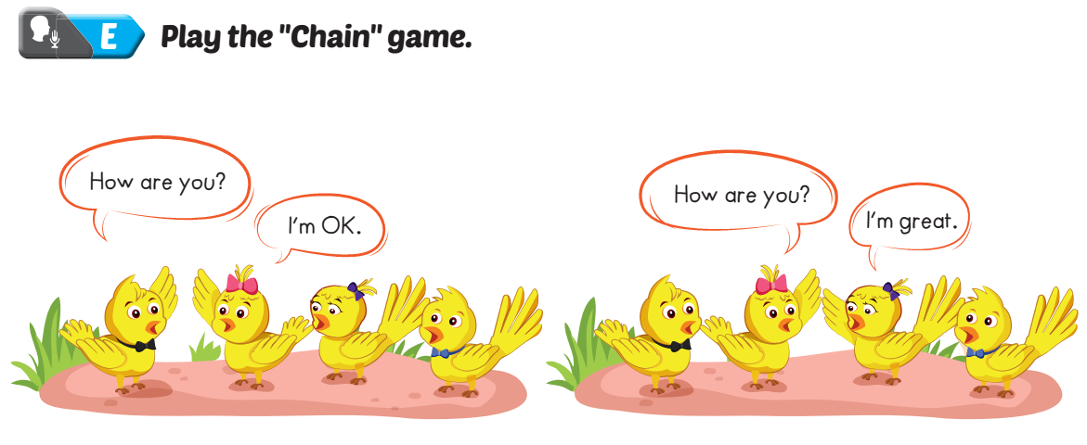
Lesson 1
Notes:
Click on the words, they will move and match up with the pictures.

Slide 5
Lesson 1
Notes:
Click on the words, they will move and match up with the pictures.

Slide 6
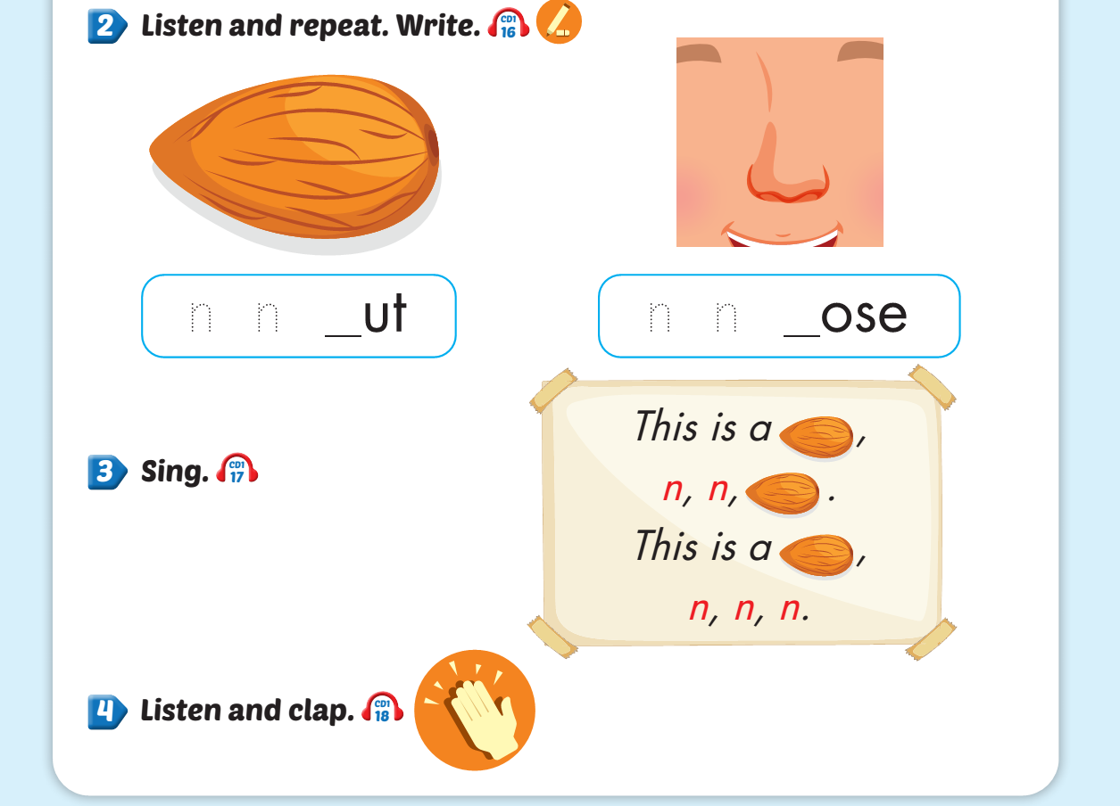
Lesson 1
Notes:
Click on the words, they will move and match up with the pictures.

Slide 7
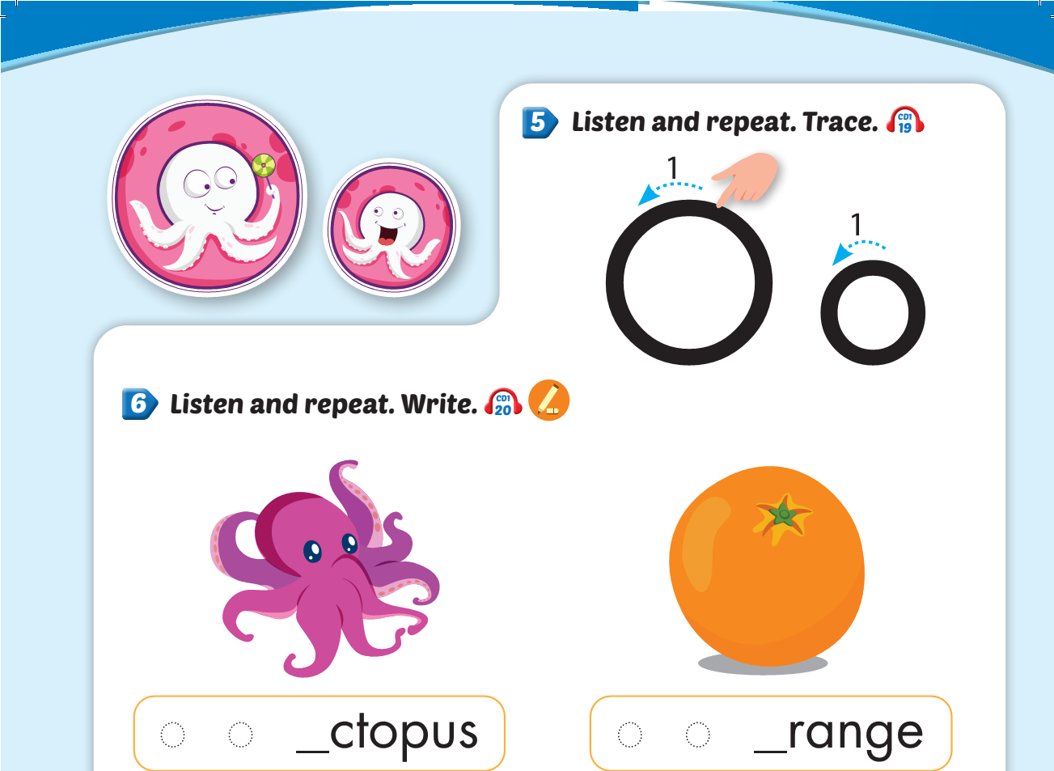
Lesson 1
Notes:
Click on the words, they will move and match up with the pictures.

Slide 8
Lesson 1
Notes:
Click on the words, they will move and match up with the pictures.

Slide 9
Lesson 1
Notes:
Click on the words, they will move and match up with the pictures.

Slide 10
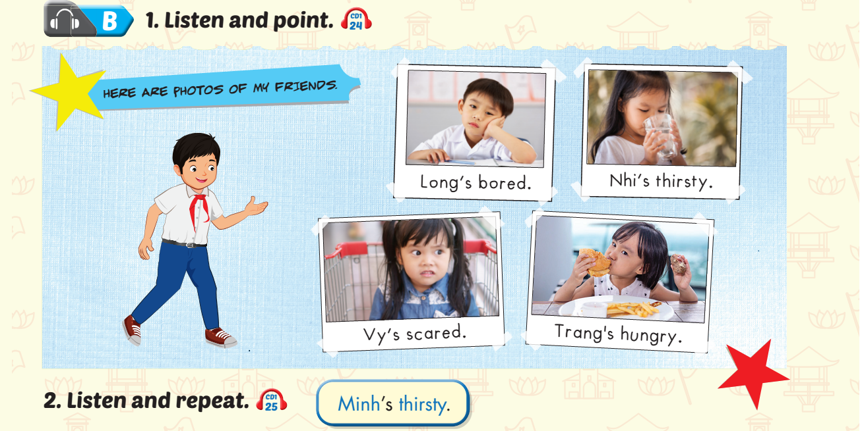
Lesson 1
Notes:
Click on the words, they will move and match up with the pictures.

Slide 11
Lesson 1
Notes:
Click on the words, they will move and match up with the pictures.

Slide 12
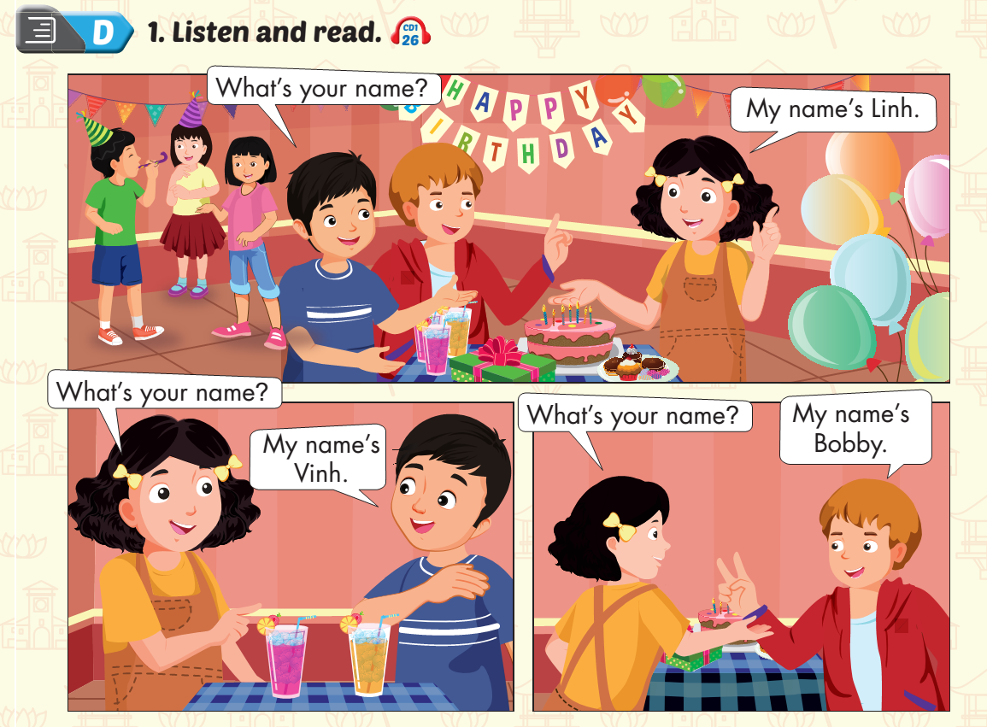
Lesson 1
Notes:
Click on the words, they will move and match up with the pictures.

Slide 13
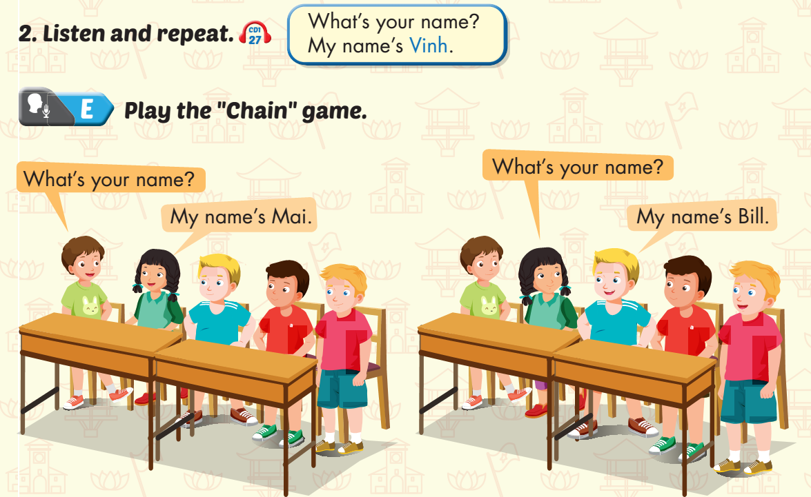
Lesson 1
Notes:
Click on the words, they will move and match up with the pictures.

