Slide 1

Getting Started
Lesson 1: Vocabulary & Sentence Patterns
Page: 4-5

Slide 2
Lesson Outline
Warm-up
Vocabulary
Structure
Practice
Production
Consolidation
Wrap-up

Slide 3
Objectives
By the end of this lesson, students will be able to gain the following:
Vocabulary:
one, two, three, four, five, six, seven, eight, nine, ten
Sentence pattern:
How old are you? - I’m (eight).
Skills:
Count from one to ten, and ask how old someone is.

Slide 4

WARM UP

Slide 5

Name Chain
Hello, my name is ______.
He/She is______.
Example:
Student 1: Hello, my name is Nina.
She is Lan.
Student 2: Hello, my name is Lan.
He is Jack.
Notes:
Name Chain
Ask the class to introduce their names.
Demonstrate the activity in front of the class.
Require the class to stand up and make a circle.
Introduce your name and pass a ball a student on your left. Ask him/her to use the structures: “Hello, my name is ____. He/She is ___.” to introduce their name and friends’ names.
Have them continue the activity with another student.

Slide 6

It’s time to learn …

Slide 7
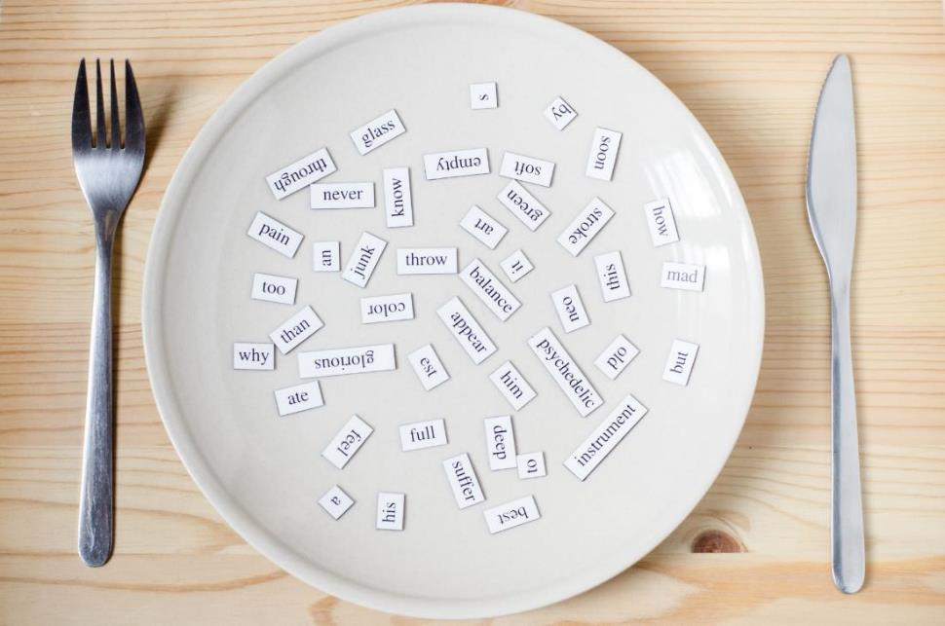
New words
one, two, three, four, five, six, seven, eight, nine, ten

Slide 8





















Click A to hear the sound
Notes:
Click vào hình A. 1. Listen and point. Repeat để cho cả audio full chạy

Slide 9
Click A to hear the sound
/wʌn/
số 1
/tuː/
số 2
/θriː/
số 3
/fɔːr/
số 4
/faɪv/
số 5
/sɪks/
số 6
/sevn/
số 7
/eɪt/
số 8
/naɪn/
số 9
/tuː/
số 10
Notes:
Click vào hình A. 1. Listen and point. Repeat để cho cả audio full chạy

Slide 10


/wʌn/
số 1
Click on each picture to hear the sound.
Notes:
Click vào hình A. 1. Listen and point. Repeat để cho cả audio full chạy

Slide 11

/tuː/
số 2
Click on each picture to hear the sound.
Notes:
Click vào hình A. 1. Listen and point. Repeat để cho cả audio full chạy

Slide 12

/θriː/
số 3
Click on each picture to hear the sound.
Notes:
Click vào hình A. 1. Listen and point. Repeat để cho cả audio full chạy

Slide 13

/fɔːr/
số 4
Click on each picture to hear the sound.
Notes:
Click vào hình A. 1. Listen and point. Repeat để cho cả audio full chạy

Slide 14

/faɪv/
số 5
Click on each picture to hear the sound.
Notes:
Click vào hình A. 1. Listen and point. Repeat để cho cả audio full chạy

Slide 15


/sɪks/
số 6
Click on each picture to hear the sound.
Notes:
Click vào hình A. 1. Listen and point. Repeat để cho cả audio full chạy

Slide 16


/sevn/
số 7
Click on each picture to hear the sound.
Notes:
Click vào hình A. 1. Listen and point. Repeat để cho cả audio full chạy

Slide 17


/eɪt/
số 8
Click on each picture to hear the sound.
Notes:
Click vào hình A. 1. Listen and point. Repeat để cho cả audio full chạy

Slide 18

/naɪn/
số 9
Click on each picture to hear the sound.
Notes:
Click vào hình A. 1. Listen and point. Repeat để cho cả audio full chạy

Slide 19

/tuː/
số 10
Click on each picture to hear the sound.
Notes:
Click vào hình A. 1. Listen and point. Repeat để cho cả audio full chạy

Slide 20
It’s time to play …

Slide 21

one
two
four
five
next

Slide 22

five
three
two
eight
next

Slide 23

two
one
four
three
next

Slide 24

eight
six
four
five
next

Slide 25

eight
five
six
seven
next

Slide 26

nine
eight
six
seven
next

Slide 27

ten
nine
eight
seven
next

Slide 28

two
ten
eight
six
next

Slide 29

nine
five
eight
three
next

Slide 30

ten
seven
nine
eight
next

Slide 31
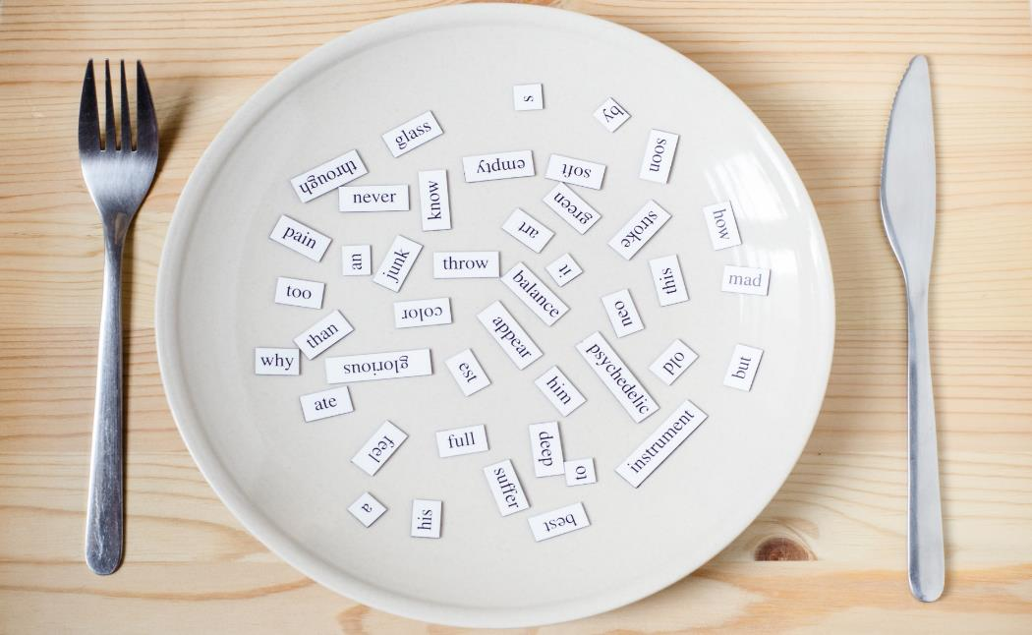
Structures
How old are you?
I’m (eight).

Slide 32

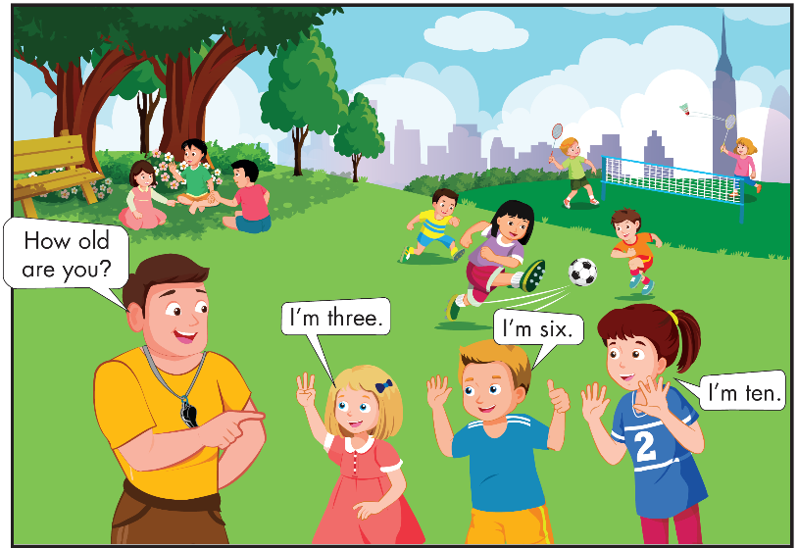
Notes:
B. Listen and point. Repeat. Role-play. (CD1 Track 03)
Have students call out the things they can see in each picture.
Play the audio and have them point to the characters.
Play the audio again and have them repeat the new words.
Divide the class into pairs to role-play the dialogue.
Swap roles and repeat.
Invite some pairs to demonstrate the activity in front of the whole class.
Go around the class and support them if necessary.

Slide 33

Practice

Slide 34


How old are you?
How old are you?
How old are you?
How old are you?
I’m four.
I’m five.
I’m four.
I’m five.
How old are you?
How old are you?
How old are you?
How old are you?
How old are you?
How old are you?
I’m seven.
I’m nine.
I’m ten.
I’m seven.
I’m nine.
I’m ten.
Notes:
B. Listen and point. Repeat. Role-play. (CD1 Track 03)
Have students call out the things they can see in each picture.
Play the audio and have them point to the characters.
Play the audio again and have them repeat the new words.
Divide the class into pairs to role-play the dialogue.
Swap roles and repeat.
Invite some pairs to demonstrate the activity in front of the whole class.
Go around the class and support them if necessary.

Slide 35

Speaking

Slide 36

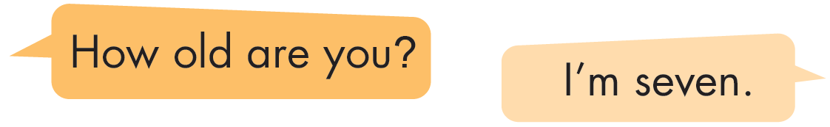
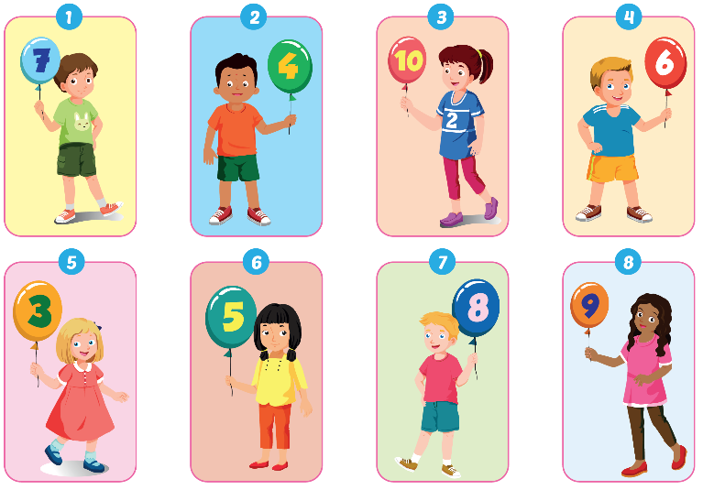

Slide 37

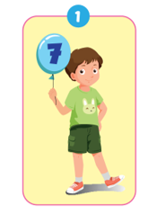


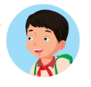
I'm seven.

Slide 38
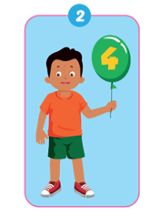
I'm four.

Slide 39
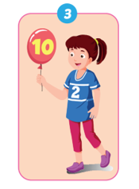
I'm ten.

Slide 40
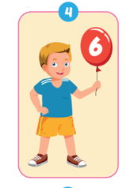
I'm six.

Slide 41
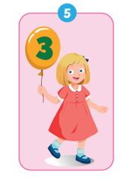
I'm three.

Slide 42
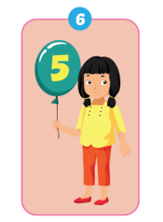
I'm five.

Slide 43
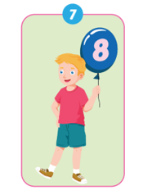
I'm eight.

Slide 44
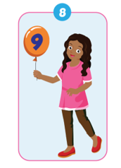
I'm nine.

Slide 45

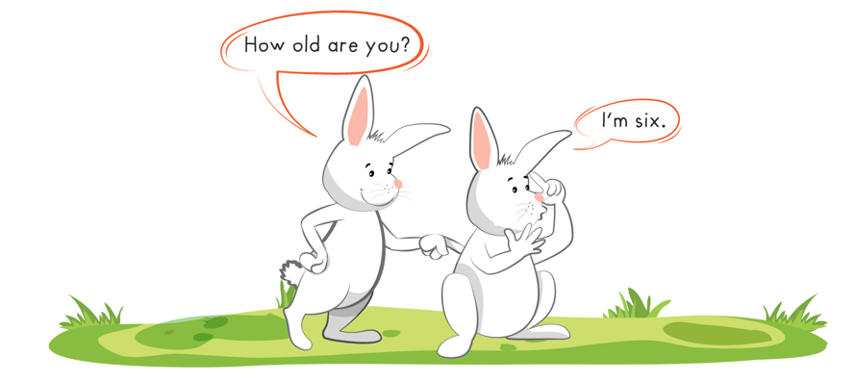

Slide 46
Further Practice

Slide 47
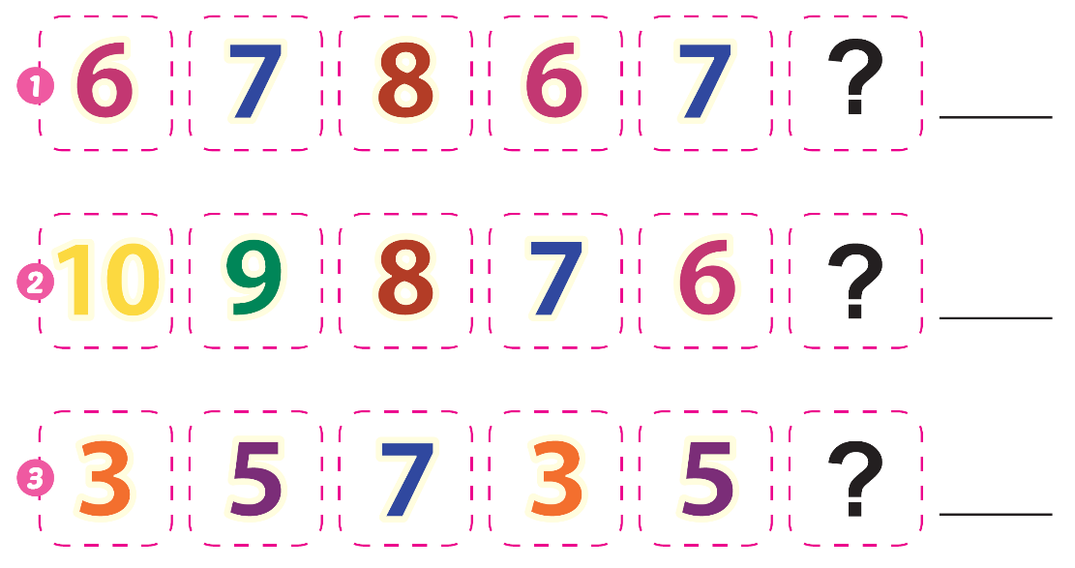



eight
five
seven

Slide 48

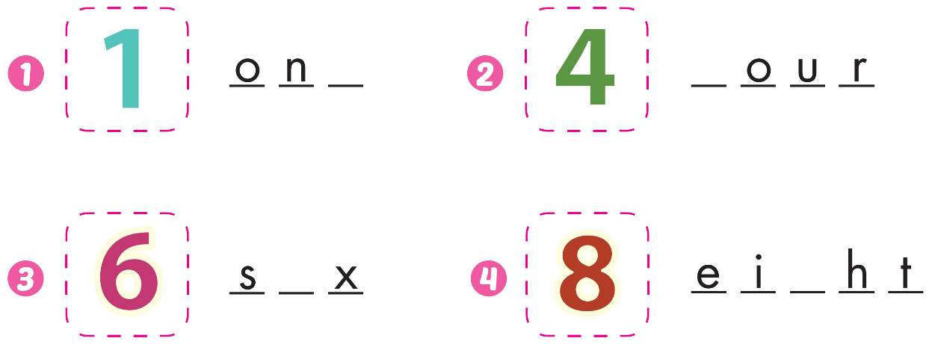
e
f
i
g

Slide 49

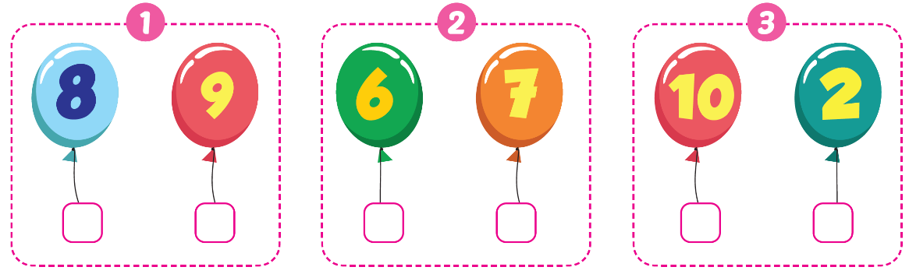





Slide 50

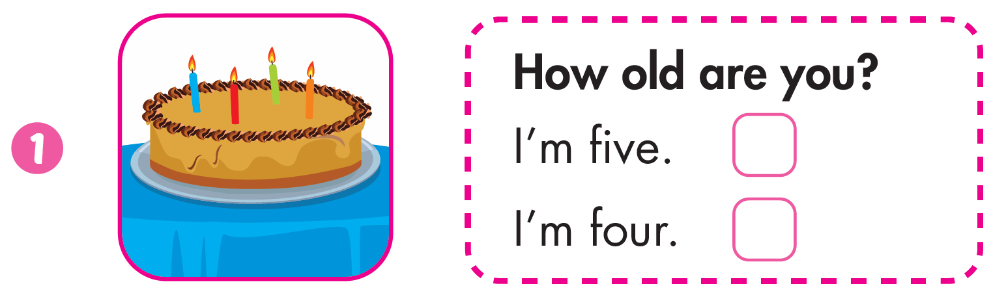


Slide 51
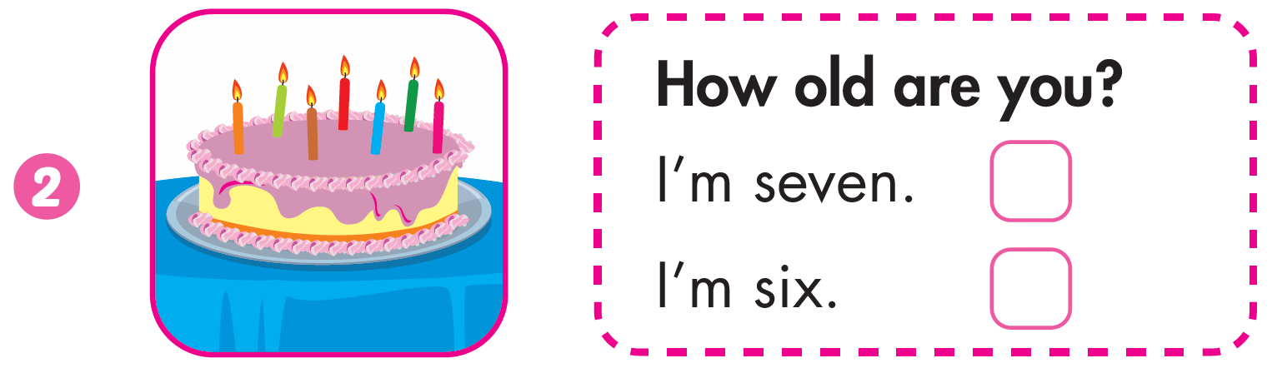

Slide 52
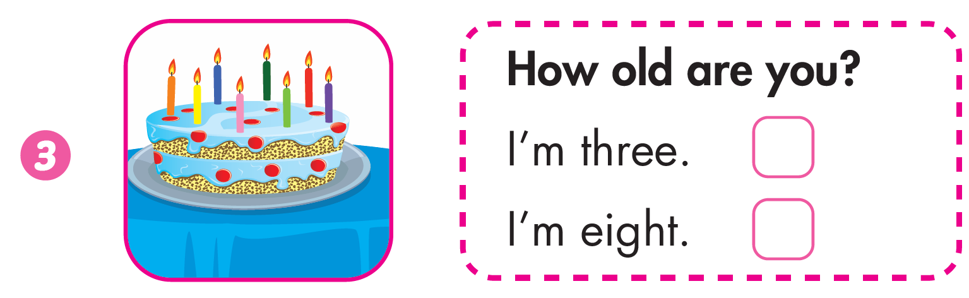

Slide 53

CONSOLIDATION

Slide 54





Notes:
Thanh Yến Trần 0967 255 149 zalo/ FB https://www.facebook.com/thanhyentrananhngutaymy/

Slide 55









2
3
1

Slide 56

1
3
2
Notes:
Thanh Yến Trần 0967 255 149 zalo/ FB https://www.facebook.com/thanhyentrananhngutaymy/

Slide 57

3
1
2

Slide 58
9
5
7

Slide 59
8
6
2
Notes:
Thanh Yến Trần 0967 255 149 zalo/ FB https://www.facebook.com/thanhyentrananhngutaymy/

Slide 60
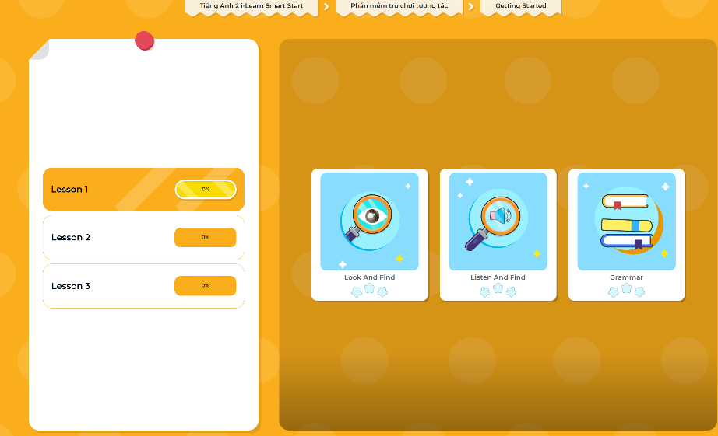
Extra Practice
DHA App
LET’S PLAY!
Click here to play the games

Slide 61

WRAP-UP

Slide 62
Today’s lesson
Vocabulary
one, two, three, four, five, six, seven, eight, nine, ten
Structures/ Sentence patterns
How old are you?
I’m (eight).

Slide 63
Homework
Practice vocabularies and structure. Make sentences using them.
Practice the vocabulary and structure in Tiếng Anh 2 i-Learn Smart Start Notebook (pages 2,3)
Do the exercises in Tiếng Anh 2 i-Learn Smart Start Workbook (page 2)
Play the consolidation games in Tiếng Anh 2 i-Learn Smart Start DHA App on www.eduhome.com.vn
Prepare the next lesson (pages 6,7)

Slide 64

Enjoy your day!

