Slide 1

Getting Started
Lesson 2: Vocabulary & Sentence Patterns
Page: 6-7

Slide 2
Lesson Outline
Warm-up
Vocabulary
Structure
Practice
Production
Consolidation
Wrap-up

Slide 3
Objectives
By the end of this lesson, students will be able to gain the following:
Vocabulary:
open your book, close your book, hands up, hands down
Sentence patterns:
“Open your book!” “Close your book!”
“Hands up!” “Hands down!”
Skills:
Understand and follow simple instructions in class.

Slide 4

WARM UP

Slide 5
COUNTING
“How many…”
You are divided into 2 teams: team A and team B
I’ll show a picture which has many numbers on it.
You have to find out how many number 1 or 2 or 3…
Which team has the answer first will get 1 point.

Slide 6
2
2
How many numbers 1?
1
2
2
2
1
1
1
2

Slide 7
3
How many numbers 2?
5
2
4
3
7
2
2
4

Slide 8
4
How many numbers 5?
5
5
4
3
2
5
5
5
2

Slide 9
5
How many numbers 7?
7
7
1
7
3
7
7
7
2

Slide 10
2
2
How many numbers 4?
4
4
2
2
4
4
4
2

Slide 11
2
2
How many numbers 8?
8
2
8
2
8
8
2
8

Slide 12
How many numbers 10?
10
10
10
8
10
10
10
2

Slide 13

It’s time to learn …

Slide 14
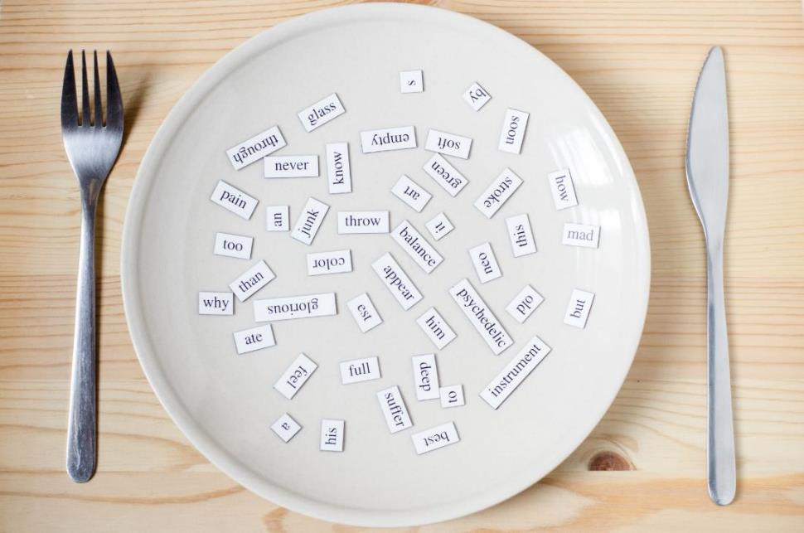
New words
open your book, close your book, hands up,
hands down

Slide 15

Presentation

Slide 16

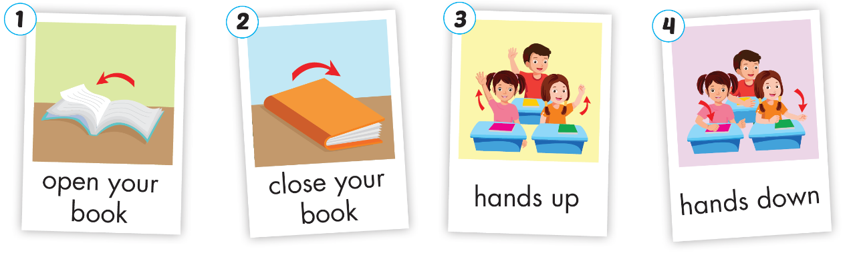
Click A to hear the sound
Notes:
Click vào hình A. 1. Listen and point. Repeat để cho cả audio full chạy

Slide 17




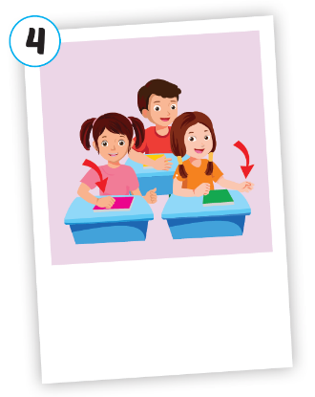




Click A to hear the sound
/ˈoʊpən jər bʊk/
mở sách ra
/kloʊz jər bʊk/
đóng sách lại
/hændz ʌp//
giơ tay lên
/hændz daʊn/
hạ tay xuống
Notes:
Click vào hình A. 1. Listen and point. Repeat để cho cả audio full chạy

Slide 18

/ˈoʊpən jər bʊk/
mở sách ra
Notes:
Click vào hình A. 1. Listen and point. Repeat để cho cả audio full chạy

Slide 19

/kloʊz jər bʊk/
đóng sách lại
Notes:
Click vào hình A. 1. Listen and point. Repeat để cho cả audio full chạy

Slide 20

/hændz ʌp//
giơ tay lên
Notes:
Click vào hình A. 1. Listen and point. Repeat để cho cả audio full chạy

Slide 21

/hændz daʊn/
hạ tay xuống
Notes:
Click vào hình A. 1. Listen and point. Repeat để cho cả audio full chạy

Slide 22
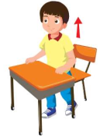


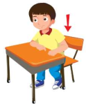

I see the photos
START

Slide 23


Rule
Click on the red button
and a photo will appear.
- Look at the photo and say the command.

Slide 24



check
Hands up.
next

Slide 25
check
Close your book
next

Slide 26
check
Open your book.
next

Slide 27

check
Hands down, please.
next

Slide 28
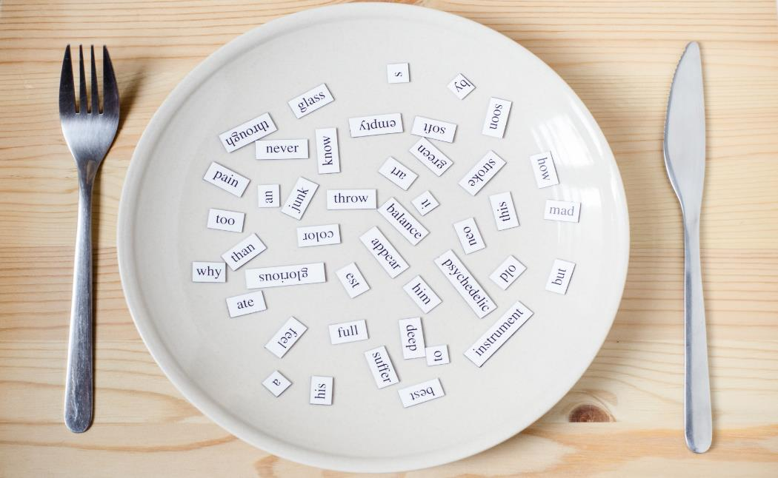
Structures
“Open your book!”
“Close your book!”
“Hands up!”
“Hands down!”

Slide 29

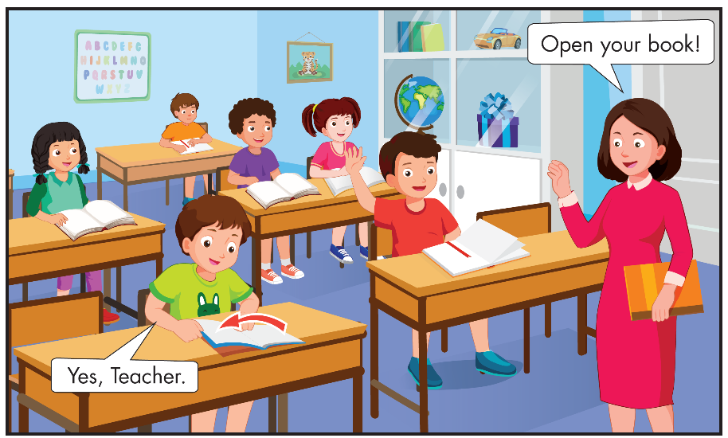

Slide 30

Practice

Slide 31


Open your book!
Hands up!
Open your book!
Hands up!
Close your book!
Hands down!
Close your book!
Hands down!
Notes:
B. Listen and point. Repeat. Role-play. (CD1 Track 03)
Have students call out the things they can see in each picture.
Play the audio and have them point to the characters.
Play the audio again and have them repeat the new words.
Divide the class into pairs to role-play the dialogue.
Swap roles and repeat.
Invite some pairs to demonstrate the activity in front of the whole class.
Go around the class and support them if necessary.

Slide 32
Speaking

Slide 33

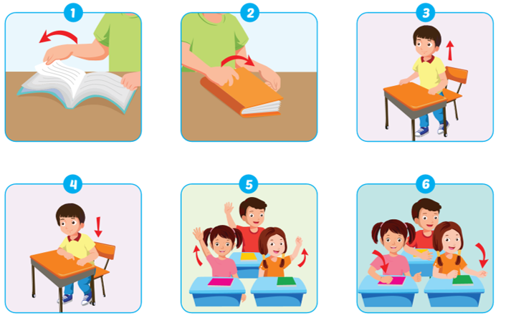


Slide 34


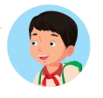
Open your book!

Slide 35
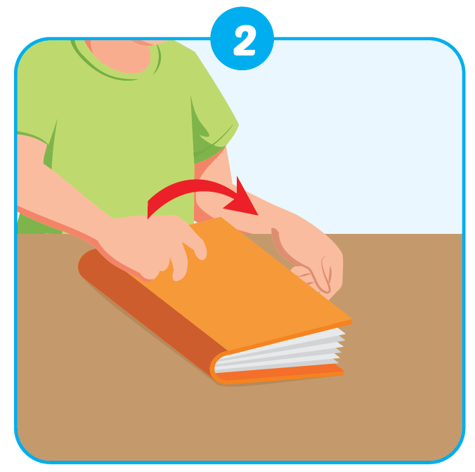
Close your book!

Slide 36
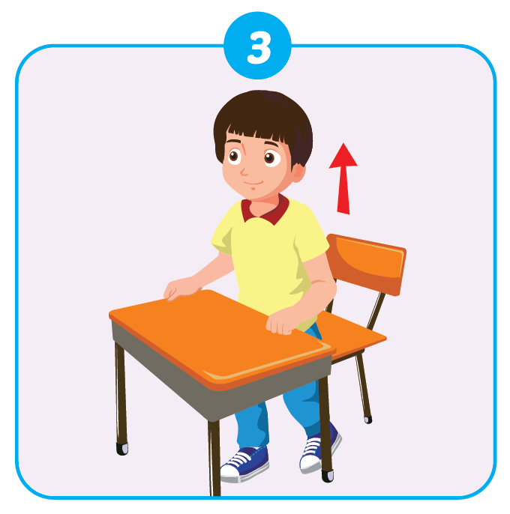
Stand up!

Slide 37
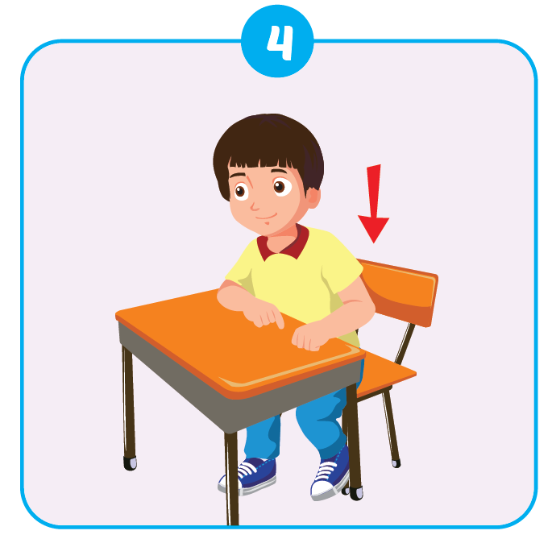
Sit down!

Slide 38
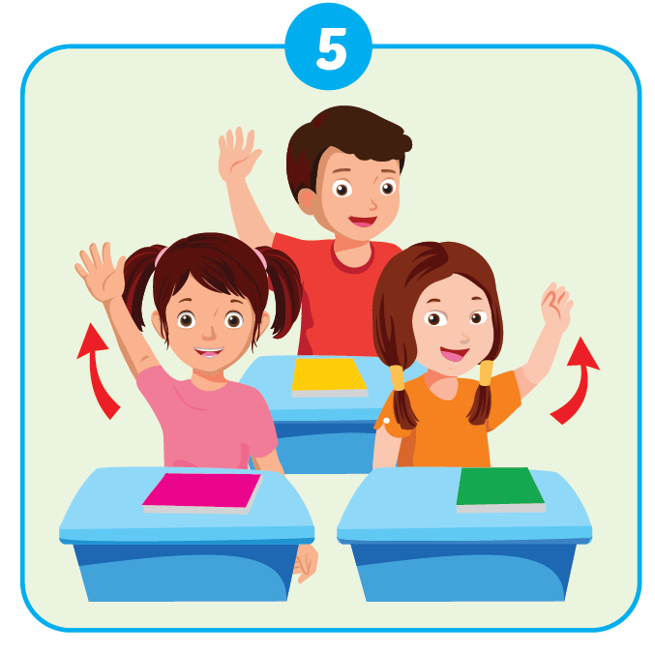
Hands up!

Slide 39
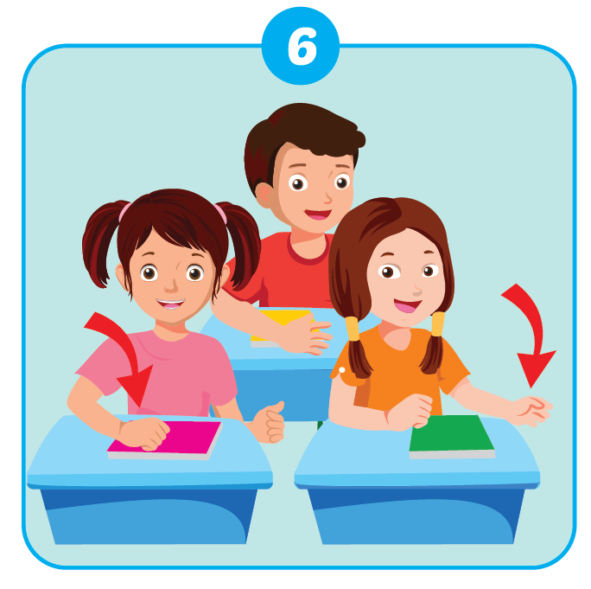
Hands down!

Slide 40

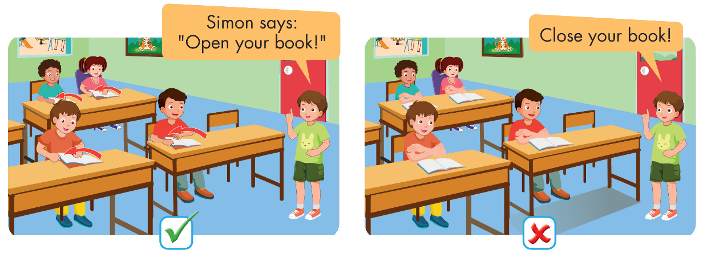

Slide 41
Further Practice

Slide 42

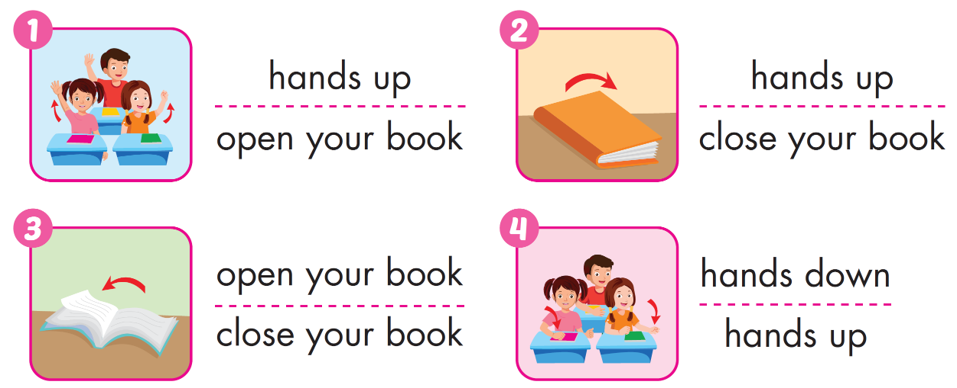


Slide 43

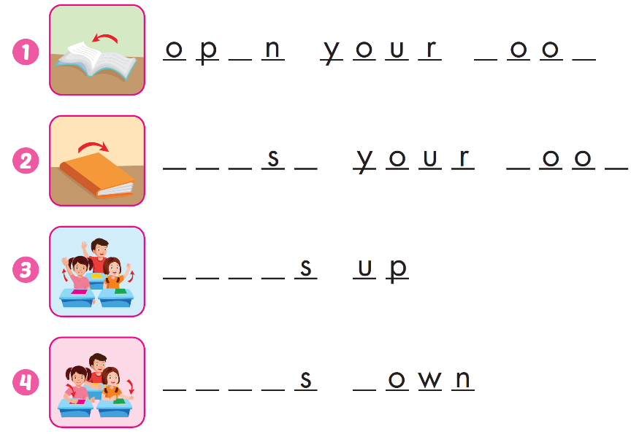
e
b
k
C
l
o
e
b
k
H
a
n
d
H
a
n
d
d

Slide 44

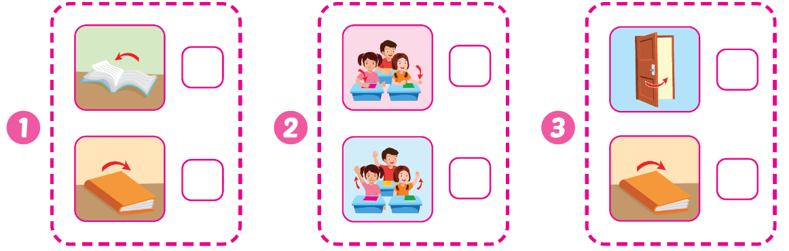





Slide 45

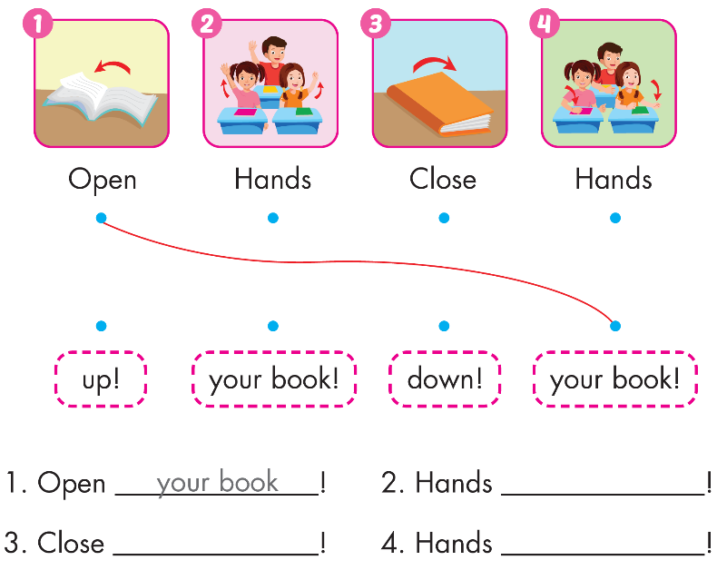
up
your book
down

Slide 46

CONSOLIDATION

Slide 47
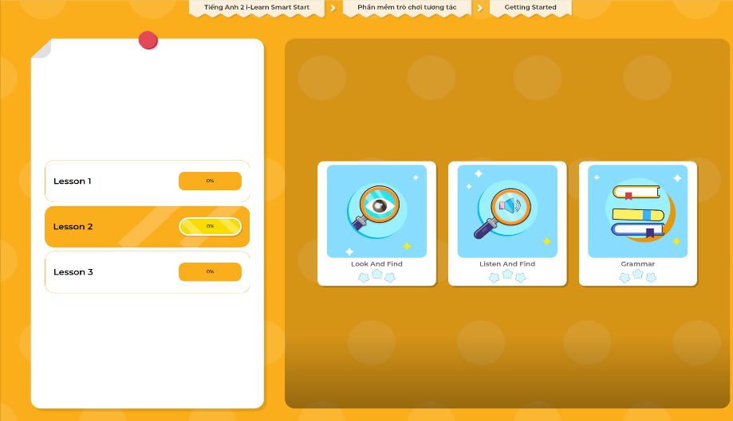
Extra Practice
DHA App
LET’S PLAY!
Click here to play the games

Slide 48

WRAP-UP

Slide 49
Today’s lesson
Structures/ Sentence patterns
“Open your book!” “Close your book!”
“Hands up!”
“Hands down!”
Vocabulary
open your book, close your book, hands up, hands down

Slide 50
Homework
Practice vocabularies and structure. Make sentences using them.
Practice the vocabulary and structure in Tiếng Anh 2 i-Learn Smart Start Notebook (pages 4,5)
Do the exercises in Tiếng Anh 2 i-Learn Smart Start Workbook (pages 4,5)
Play the consolidation games in Tiếng Anh 2 i-Learn Smart Start DHA App on www.eduhome.com.vn
Prepare the next lesson (pages 8,9)

Slide 51

Have a nice day!

